Slide 1
GCP Security Best Practices
What is GCP Security?
Why is Google Cloud Security important?
Challenges To GCP Security And Compliance
Risks associated with GCP
Different penetration testing approaches
Best Practices For Google Cloud Security
GCP Security Tools

Slide 2
What is GCP Security?
GCP security refers to measures taken by GCP customers to protect their assets and information stored in the cloud platform. It mainly includes access management, access control, and audits by cloud security service providers to ensure the confidentiality, integrity, and availability of data and resources hosted on the platform.

Slide 3
Why is Google Cloud Security important?
Cloud computing is a great way to save costs and increase the speed and efficiency of your business. If you use cloud computing options like Google Cloud Platform (GCP), you can develop and host your business applications on GCP.
The GCP penetration testing will identify the vulnerabilities and weaknesses in the GCP environment and help to fix those vulnerabilities helping you enhance GCP cloud security.
GCP penetration testing will help you identify and understand the security vulnerabilities of your GCP Cloud deployment which helps in GCP security. As a result of this test, you can get a comprehensive and thorough insight into the security of your Cloud deployment and take the necessary steps to fix the issues identified.

Slide 4
Challenges To GCP Security And Compliance
As the cloud revolution makes companies more agile, it is also upping the ante when it comes to security. The widespread availability of people, data, and infrastructure has created an interconnected world that is also incredibly vulnerable. The rise in cyber threats has forced companies to reevaluate their security measures and take action. While many still feel that the cloud is highly secure, the lack of security measures has recently come under scrutiny.

Slide 5
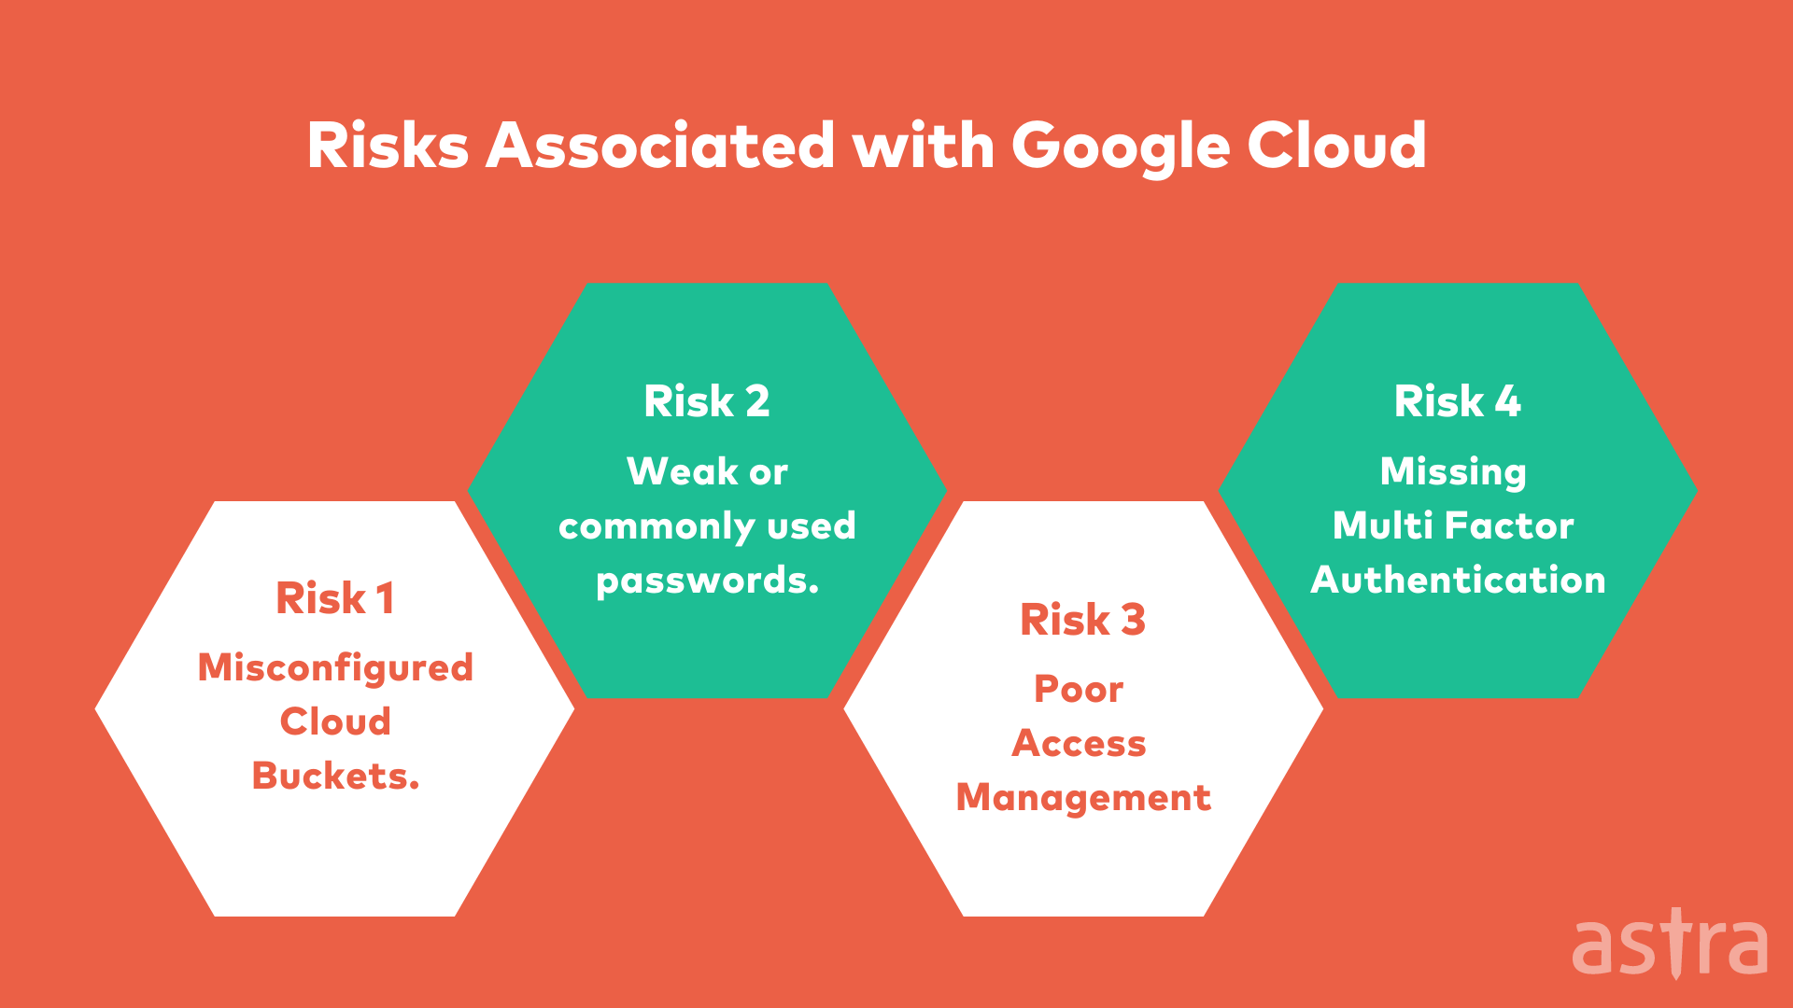
Risks associated with GCP

Slide 6
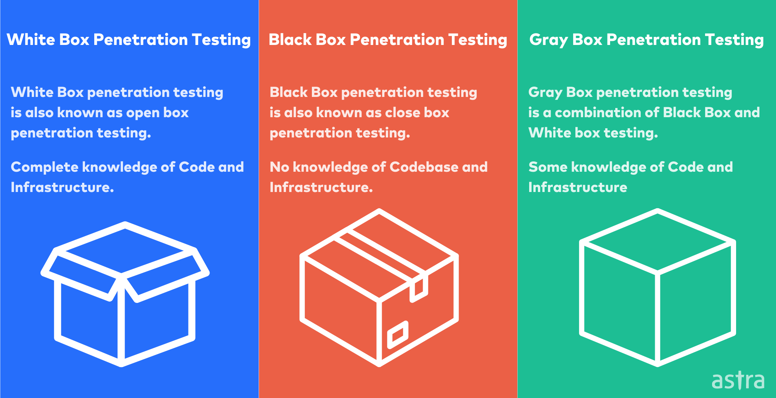
Different penetration testing approaches

Slide 7
Best Practices For Google Cloud Security
1. Implement Multi-Factor Authentication
Everyone knows that logging into a web application is the easiest way to get into a corporate environment, which is why multi-factor authentication is such a great way to prevent attacks.
While the username and password remain the easiest way for attackers to get in, multi-factor authentication adds an extra layer of security. It helps reduce the chance of successful attacks.
2. Configure Inbound Traffic properly
Inbound ports are also one of the significant controls of GCP that needs to be tested while testing your GCP infrastructure. Here the inbound ports can be secured by enforcing inbound VPC firewall rules to block unwanted traffic from the Internet to your internal cloud instances.
3. Manage Logging and Monitoring
Logging and monitoring is a vital tool to keep our systems secure and working correctly. Logs give us a history of any changes we make to our systems and allow us to troubleshoot problems and improve the performance and security of our infrastructure.
Logs give us a history of any changes we make to our systems and allow us to troubleshoot problems and improve the performance and security of our infrastructure.
4. Use Key Rotation Techniques
Key rotation is the process of exchanging existing system keys for new system keys. Keys are used to encrypt sensitive data. Keys are encrypted using encryption algorithms and then stored on the system. The rotation of keys is done to prevent an adversary from obtaining the current key, then decrypting data encrypted with that key.
Key rotation is performed by updating the encryption software with the newly generated key of the same encryption algorithm. The new key is then used to encrypt the existing data.

Slide 8
GCP Security Tools
Check out the below-mentioned list of amazing open-source tools to enhance GCP security:
GCP Firewall Enum: This tool analyzes the output of several google cloud commands to determine which compute instances have network ports exposed to the public Internet.
GCP Bucket Brute: This is a python script used to enumerate Google Storage buckets, determine what access you have to them, and determine if they can be privileged escalated.
GCP IAM Collector: This tool is a python script used for collecting and visualizing Google Cloud Platform IAM permissions by iterating over GCP projects using Google Cloud Resource Manager API.
Notes:
NOTE: Ref for all the details - https://www.getastra.com/blog/security-audit/what-is-gcp-security/

Slide 9
The End

